Slide 1
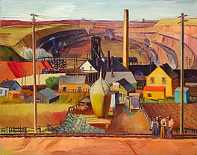
Landscapes and Environment
Next
1
2
3
4
5
6
A landscape artist creates artistic images showing large views of land. Landscapes can be created using many kinds of art media, including painting, drawing, collage, or even sculpture. Landscapes can also be created in different artistic styles, such as abstraction, romanticism, or realism.
Landscape artists can use their art as a way to express their personal views about the world around them.
E. Dewey Albinson, Northern Minnesota Mine 1934, oil, 40 x 50 1/8 in. Smithsonian American Art Museum, Transfer from the U.S. Department of Labor
Image Source: Smithsonian American Art Museum
How do artists use the landscape to communicate their observations about ecology and the interaction of man-made materials with the natural environment?

Slide 2
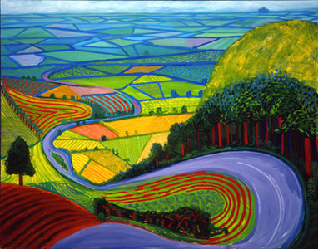
2. Information Sources
Next
1
2
3
4
5
6
Here are some examples of artists who created landscape artwork. Consider how these artists use the landscape to express their personal views about the world around them.
Ansel Adams
Claude Monet
The Hudson River School
Joel Sternfeld
Vincent Van Gogh
Landscape Painting in Chinese Art
Danny Lyon: The Destruction on Lower Manhattan
Hockney, David, Garrowby Hill, 1998 oil on canvas, 60x76 in.
Image Source: www.hockneypictures.com

Slide 3
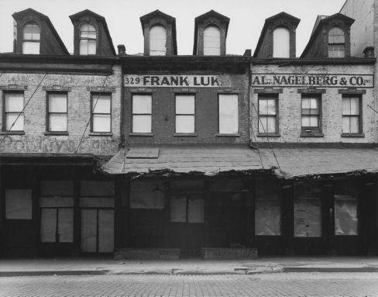
3. Student Activity
Next
1
2
3
4
5
6
Explore the resources on slide 2 to think about these questions:
How is the interaction of man-made materials with the natural environment depicted in the artwork?
What is the mood depicted in the artwork? Does the artwork suggest a positive or negative mood? How do you know?
What message is the artist trying to convey about the environment?
The Destruction of Lower Manhattan: Photographs by Danny Lyon
Danny Lyon, "327, 328, and 331 Washington Street, between Jay and Harrison Streets
Image Source: Museum of the City of New York

Slide 4
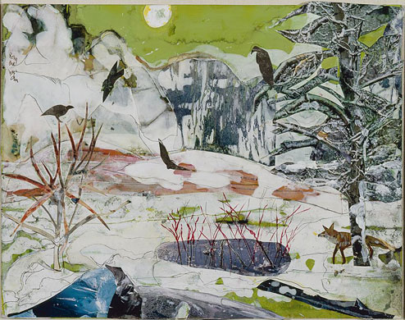
4. Assessment Activity
Next
1
2
3
4
5
6
Choose one landscape artist from the resources provided on slide 2. Make notes in your art journal as you critique and analyze:
Art medium used (oil, watercolor, photography, collage…)
Style (abstract, realistic, surreal…)
What the environmental message is that the artist conveys in his/her artwork
How the artist uses medium and style to convey the overall message about the environment
Bearden, Romare, Winter (Time of the Hawk), 1985 collage of various papers with paint, ink, and graphite on fiberboard Private collection, Charlotte, North Carolina
Image Source: National Gallery of Art

Slide 5
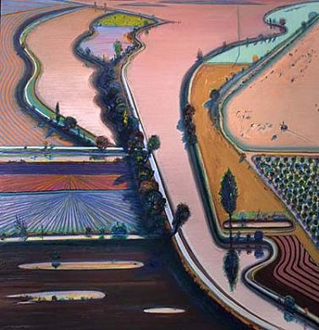
5. Enrichment Activities
Next
1
2
3
4
5
6
Extend your learning about landscapes, art styles, and art elements and principles:
Courbet and the Modern Landscape
JMW Turner
Bernd and Hilla Becher, Photography
Romare Bearden Landscapes
National Gallery of Art for Kids: Rousseauian Jungle Landscape
Birmingham Museum: Learning About Landscapes
Scoop-It “Landscapes and Environment”
Art Styles and Movements
SFMOMA Art Basics: a slide show that explains the elements of art
Levee Farms
1998 Wayne Thiebaud Born: Mesa, Arizona 1920 oil on canvas 48 x 48 in. (121.9 x 121.9 cm) Smithsonian American Art Museum
Image Source: Smithsonian American Art Gallery

