Slide 1
Mexican Basketry

Slide 2
History
Basketry is one of Mexico’s oldest handcrafts and was developed by the Indigenousness people. (Indigenousness people are those people who originally inhabited a land prior to the arrival of any explores, settlers, or migrants.)
Baskets addressed the people’s need to carry and store food and other items and provided a lightweight and sturdy means of doing so.

Slide 3
Geographic regions
The important tradition of basketry continues today in the Mexican states of…
Sonora
The State of Mexico
Michoacan
Veracruz
Oaxaca
Yucatan Peninsula

Slide 4
Materials
The most common materials used to make Mexican baskets are various types of reeds and rushes harvested from shallow lakes, ponds and slower- moving rivers and streams, but a number of more unusual materials are used as well.
These include willow and other thin tree branches, yucca leaves, palm fronds (from many species), yucca leaves, long pine needles, dried lily plants, wheat and rye straw, and long thorns and other parts of cactus and other succulents.

Slide 5
Techniques
The oldest technique for creating baskets is coiling, with the best-known example of this being the corita baskets of the Seri and other peoples of northwest Mexico.

Slide 6
Baskets of The Seri People of Sonora
Mexican Basketry

Slide 7
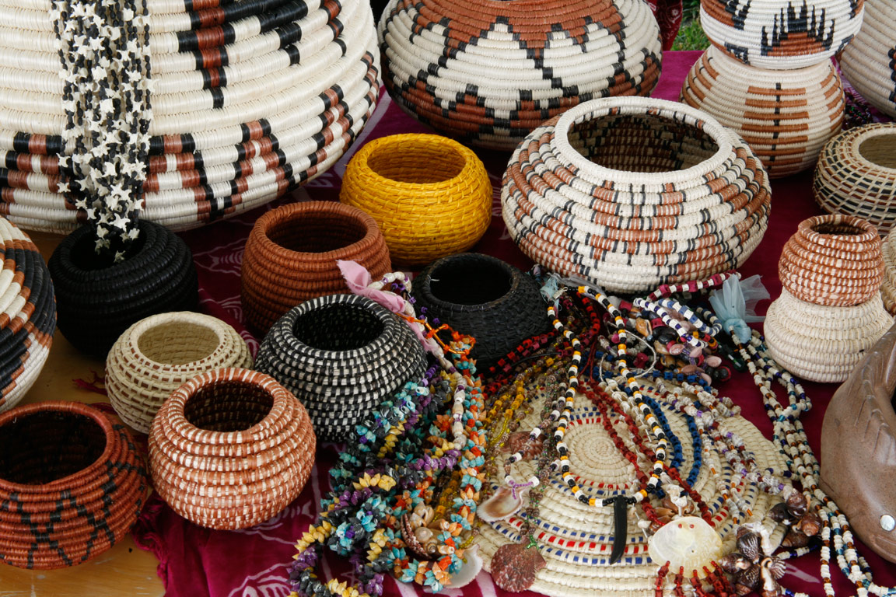

Slide 8
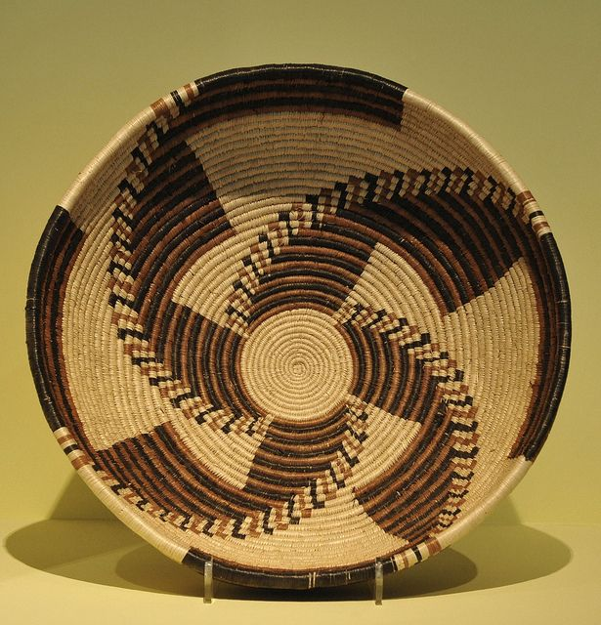

Slide 9
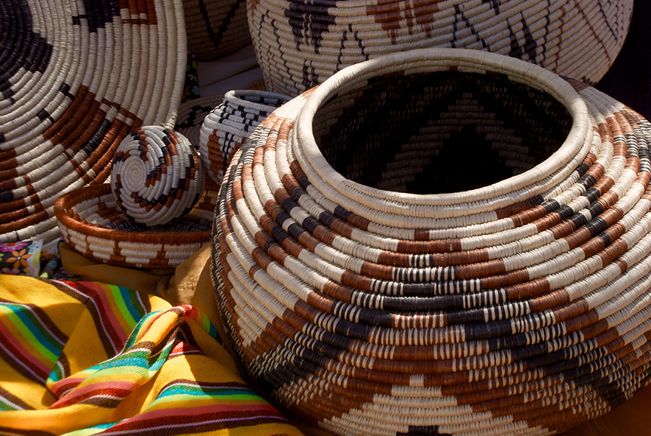

Slide 10
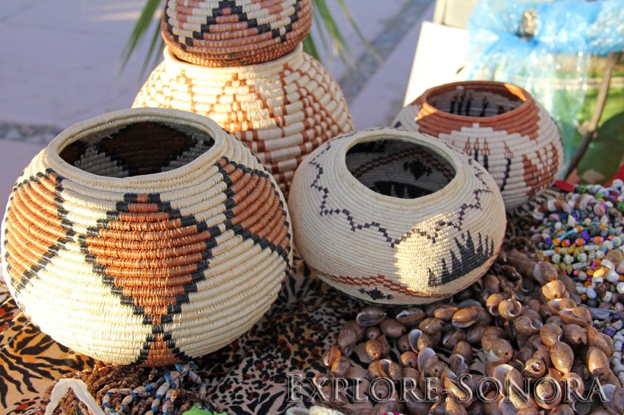

Slide 11
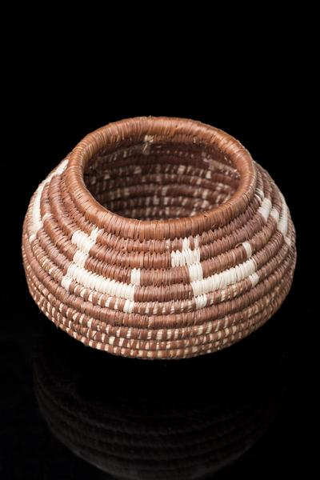
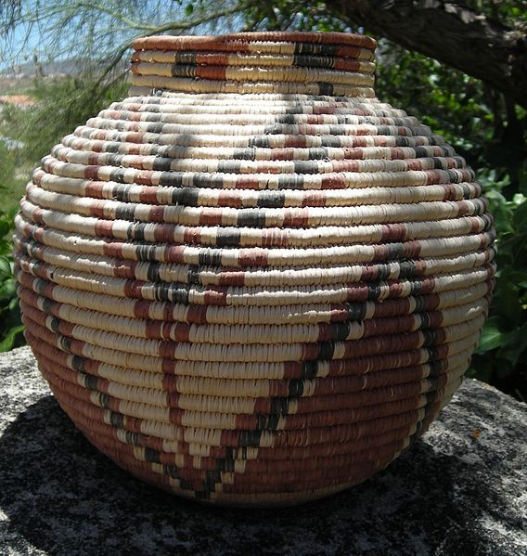

Slide 12
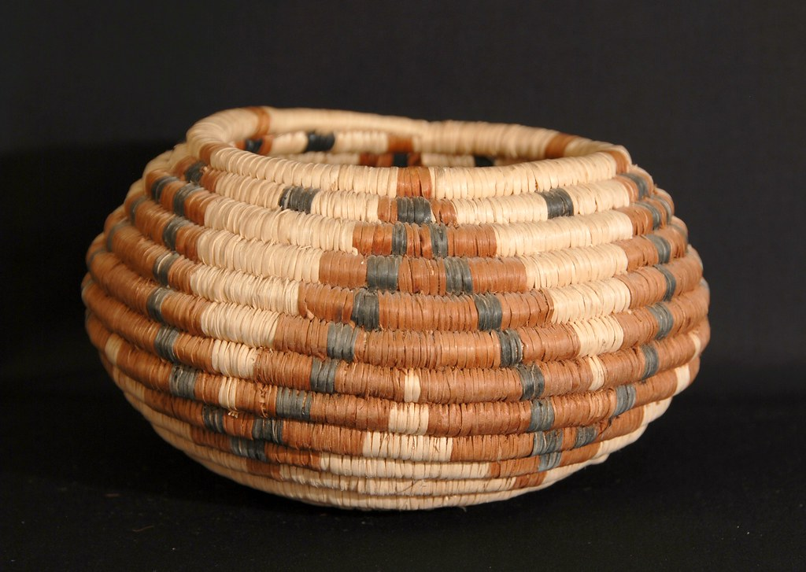
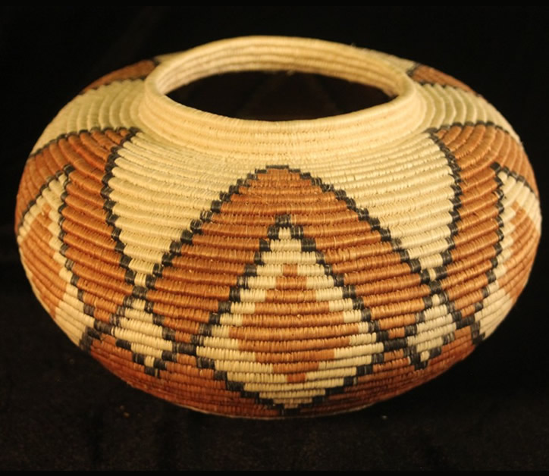
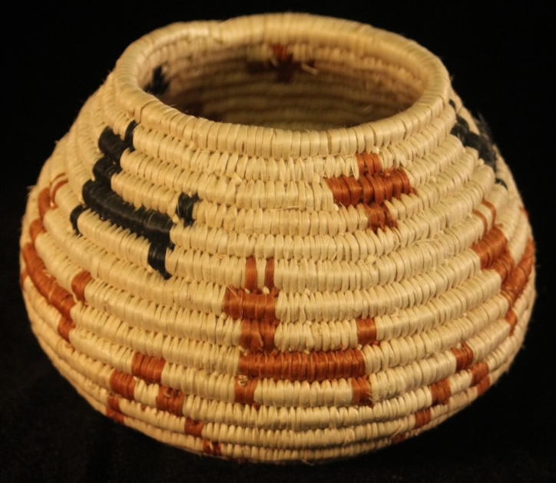
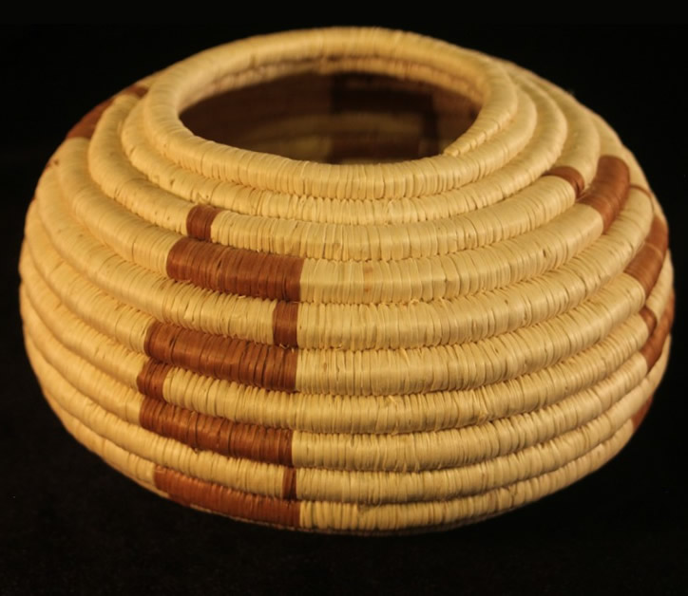

Slide 13
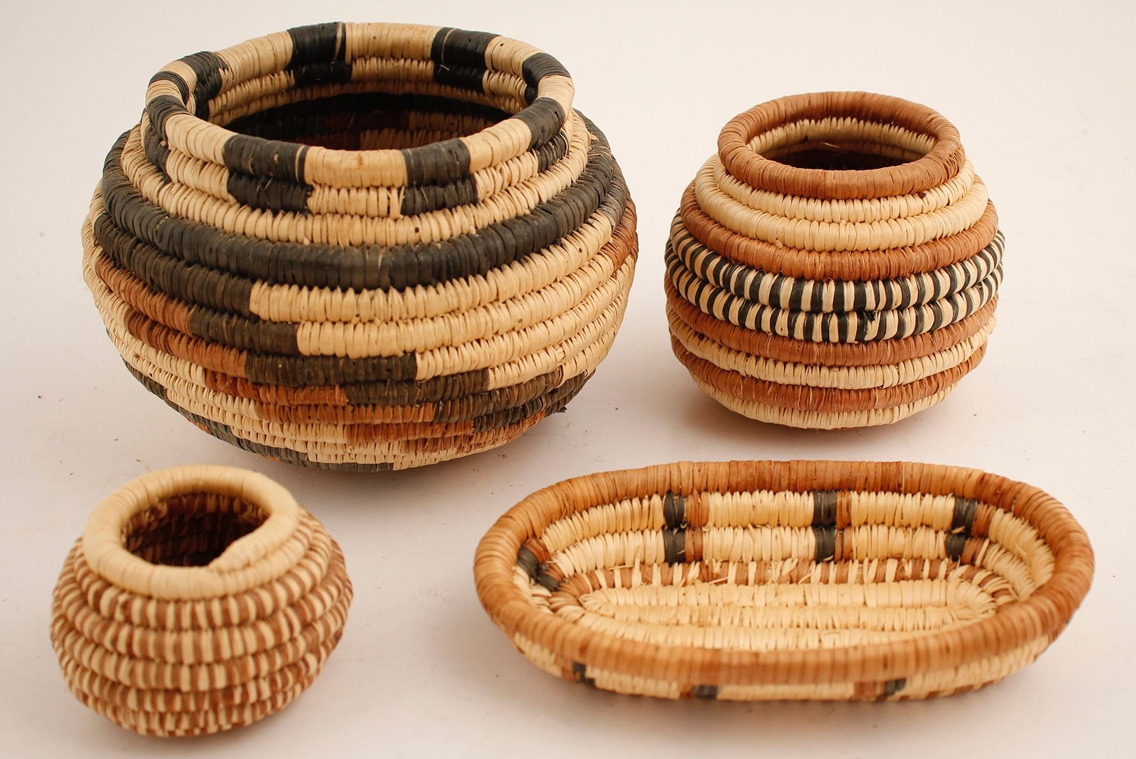

Slide 14
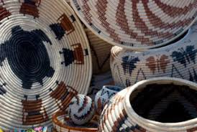

Slide 15
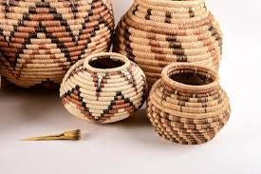

Slide 16
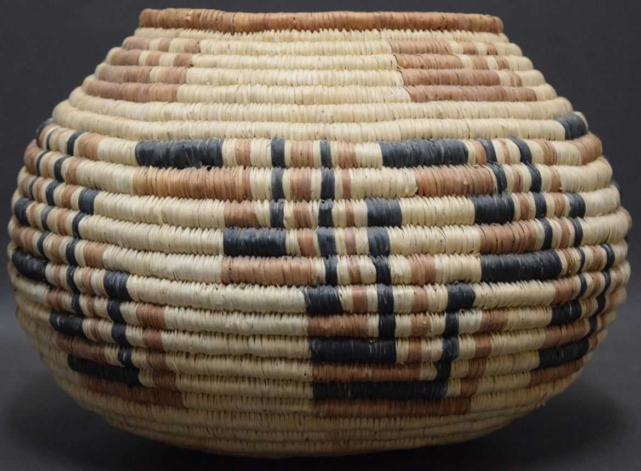

Slide 17
