Slide 1
Perspective Drawing
One-Point Perspective

Slide 2
Perspective
During the Renaissance artists became interested in making two-dimensional artwork (objects that have length and width) look three-dimensional (objects having height, width, and depth) .
Renaissance- (1450-1600): The Renaissance began in Italy and spread through Northern Europe. Art, Science, and Literature grew during this time.

Slide 3
Many of the earlier works artists created showed little depth (in drawing depth is the receding space that indicates a three dimensional space).
Does this picture reflect depth? Why or why not
How could this picture be changed to increase its’ depth?
Kaufmann Haggadah. Spain, late 14th C.

Slide 4
Artists used mathematics and close observation to invent linear perspective.
Linear perspective (allows artists to trick the eye into seeing depth on a flat surface)

Slide 5
Raphael, School of Athens,
One-point linear perspective

Slide 6
Many artists have used a variety of different techniques to show depth. However it was not until the Renaissance that artists developed a system to show depth logically and consistently.
Linear Perspective:
Based on the way the human eye sees the world.
Objects that are closer appear larger, more distant objects appear smaller.
To create the illusion of space the artists creates a vanishing point on the horizon line.
Objects are drawn using orthogonal lines, which lead to the vanishing points.

Slide 7
Vanishing Point (The single point on the horizon where all the lines on the ground level seem to come together)
Horizon Line (The place where the land and the sky meet)
Can you locate the horizon line?
How did you determine this?
Can you find the vanishing point in this picture?

Slide 9
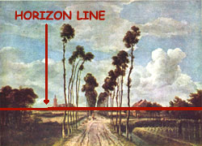
The red line is the horizon line.

Slide 10
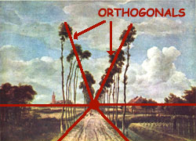
Can you locate the vanishing point?

Slide 11
Artists use one-point perspective to show objects face-on.
Most lines are vertical, horizontal, or orthogonal drawn to a single vanishing point.

Slide 12
The horizon line is horizontal, it goes from left to right and is parallel to the bottom edge of the picture.
It represents the viewer’s eye level and is the place where the ground and the sky seem to meet.
You can see the top of an object if it is below eye level or below the horizon line.
If an object is above eye level or above the horizon line, you can not see it’s top.

Slide 13
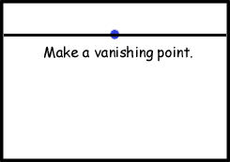
Place a dot in the middle of the horizon line. This is your vanishing point. In one-point perspective the vanishing point, represented, is always on the Horizon Line. As things get closer to the vanishing point they get smaller and smaller until they appear to vanish.

Slide 14
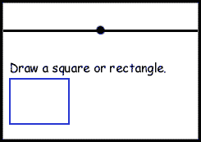
Draw a square or rectangle In your picture plane.

Slide 15
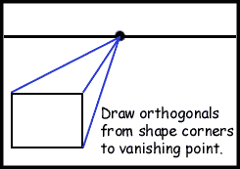
Now connect three corners of your rectangle or square to the vanishing point. These are orthogonals.

Slide 16
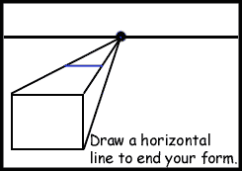
Draw a horizontal line between the two orthogonals
where you want your forms to end.

Slide 17
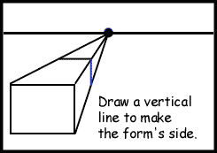
Vertical lines go from the top of the page to bottom of the page and are perpendicular to the bottom edge of the picture. Along with orthogonal and horizontal lines they make up a one-point perspective drawing.

Slide 18
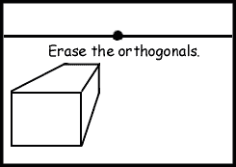
Erase the orthogonals to complete your form. You now have a 3-D form in one-point perspective.

Slide 19
