Slide 1
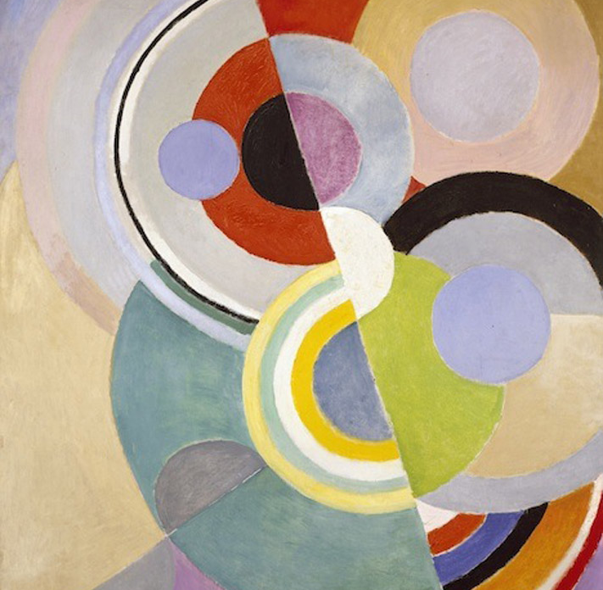
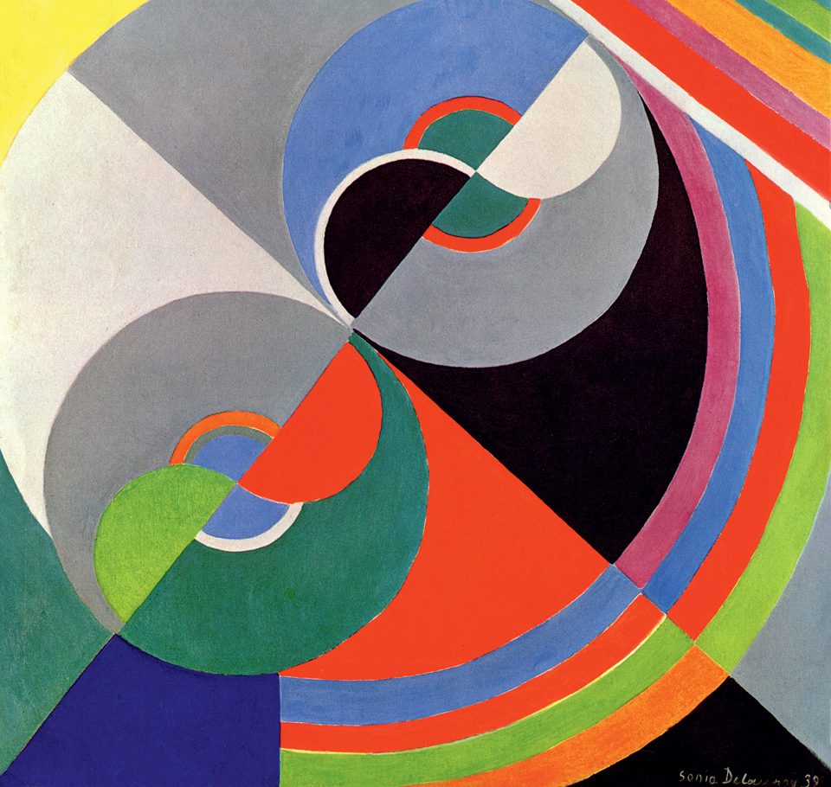
Sonia Delaunay
Colored Rhythm ~ 1946
Rhythm Color No. 1076 ~ 1939

